Slide 1

City Information And Search System
By
A.Keerthi 21J41A66D3
B.Sreelekha 21J41A66D5
G.Snehalatha 21J41A66E6
Y.Goutham 21J41A66K4
Department of Computer Science Engineering(AIML)
MALLA REDDY ENGINEERING COLLEGE(AUTONOMOUS)
Maisammaguda,Dulapally

Slide 2
Contents
Introduction
Benefits
Features
Users Review and Ratings
Privacy and Data Security
Future Developments and Innovations
Software Environment
Conclusion
References

Slide 3
Introduction :
A city information and search system is a digital platform that provides comprehensive and up-to-date information about cities.
This system helps users find relevant information about various aspects of a city, including attractions, events, transportation, and more.
It allows users to search for specific information, making it easier to navigate and explore a city.

Slide 4
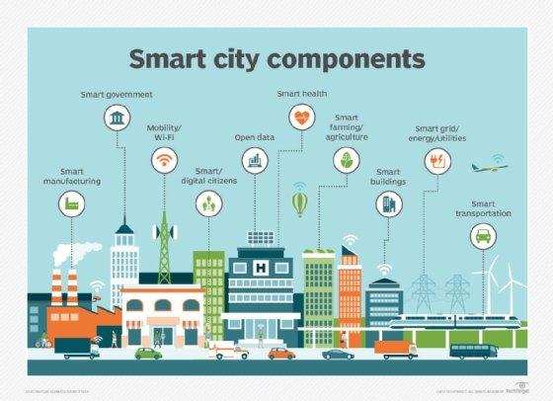
Benefits :
The city information and search system saves time and effort by providing all the necessary information in one place.
It helps users make informed decisions when planning a visit or moving to a new city.
The system enhances user experience by providing personalized recommendations based on individual preferences and interests.

Slide 5
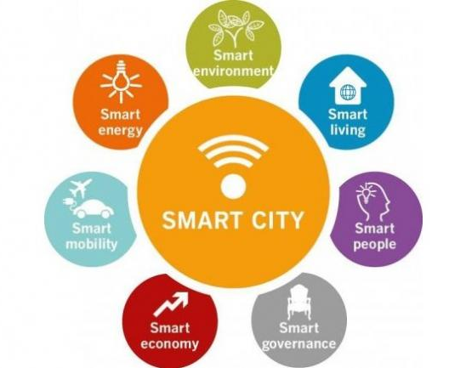
Features :
The system includes a search function that allows users to look for specific information, such as restaurants, hotels, or tourist attractions.
It offers detailed information about each point of interest, including opening hours, ratings, and reviews.
The system provides real-time updates on events, traffic, and public transportation, ensuring users have the latest information.

Slide 6
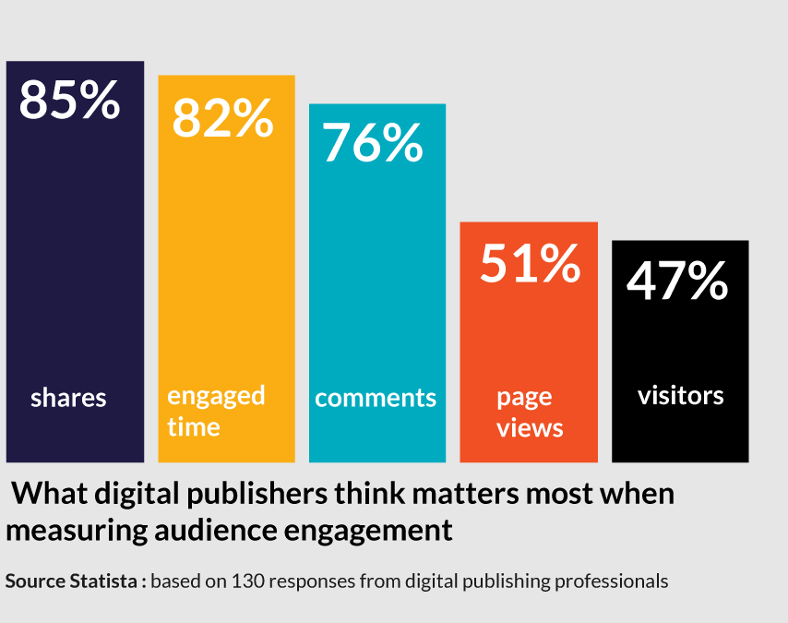
User Reviews and Ratings:
The system encourages user engagement by allowing users to leave reviews and ratings for places they have visited.
User reviews provide valuable insights and. recommendations for other users.
The rating system helps users make quick decisions based on the overall reputation of a place.

Slide 7

Privacy and Data Security:
The city information and search system prioritizes user privacy and data security.
User data is protected through advanced encryption and secure data storage practices.
The system adheres to privacy regulations and obtains user consent for data collection and usage.

Slide 8
Future Developments and Innovations:
The city information and search system constantly evolves to incorporate new technologies and features.
Future developments may include augmented reality (AR) integration for enhanced exploration and navigation.
The system may also incorporate machine learning algorithms to provide more personalized recommendations.

Slide 9
Conclusion:
City information and search systems have revolutionized the way we explore and interact with cities.
These systems empower users with comprehensive information, personalized recommendations, and efficient navigation.
By leveraging technology, city information and search systems contribute to creating better-informed and enjoyable urban experiences.

Slide 10
References:
JAVA Technologies
JAVA Complete Reference
Java Script Programming by Yehuda Shiran
Mastering JAVA Security
JAVA2 Networking by Pistoria
JAVA Security by Scotl oaks
Head First EJB Sierra Bates
J2EE Professional by Shadab siddiqui
JAVA server pages by Larne Pekowsley
JAVA Server pages by Nick Todd
HTML
HTML Black Book by Holzner
JDBC
Java Database Programming with JDBC by Patel moss.
Software Engineering by Roger Pressman

Slide 11


